Slide 1

Mobile app development
- Santosh s katti

Slide 2


introduction
Mobile Application Development (APIs – data access / testing etc)
Mobile Applications and Device Platforms (Android/iOS/OEMs)
Alternatives for Building Mobile Apps
Native Mobile Applications
Cross-Platform Native Mobile Applications
Hybrid Mobile Applications
Progressive Web Applications
MR. SANTOSH S KATTI, PES UNIVERSITY, BENGALURU

Slide 3
introduction
Comparing Native vs. Hybrid Applications
At the highest level, there are four main ways that native apps differ from hybrid apps as illustrated in the following table.
Native | Hybrid
Platform Specific | Cross Platform
Compiled Language | Scripting / Compiled
Access to Device Hardware | Plugins / Native Modules
Platform Frameworks | Web Frameworks
MR. SANTOSH S KATTI, PES UNIVERSITY, BENGALURU

Slide 4
Why Hybrid / cross platform
Why Choose the Hybrid/Cross-platform Approach?
Because of problems with native development
Specialised skill set (C/Java..),
native development only,
high demand for such developers (Retain / outsource)
How Hybrid and Cross-platform Frameworks Work
Encapsulate web applications in a container
Run on embedded browser environment
MR. SANTOSH S KATTI, PES UNIVERSITY, BENGALURU

Slide 5
Why Hybrid / cross platform
Most cross-platform frameworks such as - React Native and Native Script - provides native components to work with the cross-platform code, while some others such as Flutter and Xamarin compiles cross-platform code to the native code for better performance.

Slide 6
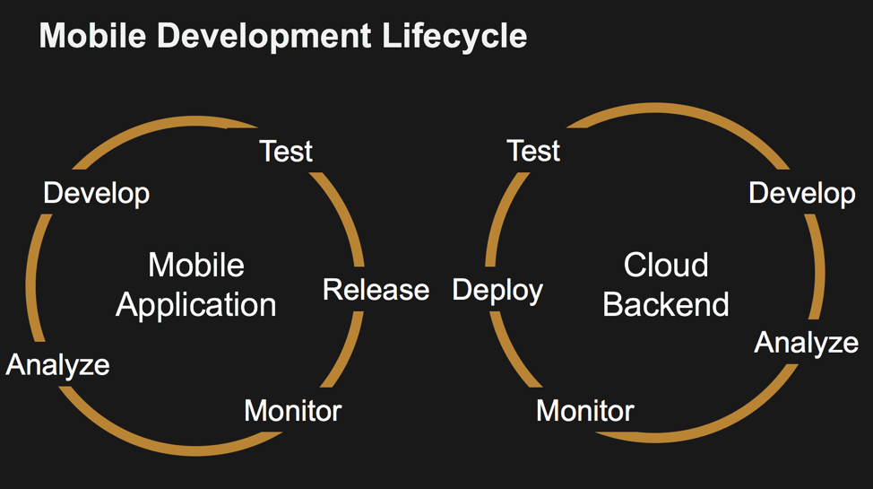
introduction
Mobile Application Development Life Cycle
MR. SANTOSH S KATTI, PES UNIVERSITY, BENGALURU

Slide 7
Front-end vs back-end
At first, the applications and sites where wholly contained within themselves and acted as little more than static advertisements for the brand, company, product, or service.
As connectivity and network capabilities improved, the applications became increasingly connected to sources of data and information that lived outside of the app itself, and the apps became increasingly dynamic as they were able to update their UI and content with data received over the network from queries to data sources.
As a result, the mobile front-end applications increasingly rely on and integrated with back-end services which provide data to be consumed through the mobile front-end. Such data can include, for example, product information for e-commerce apps or flight info for travel and reservation apps. For a mobile game, the data may include new levels or challenges and scores or avatars from other players.

Slide 8
How front-end talks to back-end
The mobile front-end obtains the data from the back-end via a variety of service calls such as APIs. In some cases, these APIs may be owned and operated by the same entity developing the mobile application. In other cases, the API may be controlled by a third party and access is granted to the mobile application via a commercial arrangement.
For example, a developer may obtain social media or advertising content by making calls to media or advertising company services. In this case, a developer may have to sign a contract in order to obtain credentials and a key that grants access to the API and governs how that developer can use it, how much it will cost, or how frequently it may be called, or how much data can be requested over what time period.

Slide 9
Why Developers Use a Cloud-backend?
For most of the applications, mobile developers are responsible for creating and managing the back-end services for their application. The mobile developer may not be an expert or even particularly skilled in spinning up and running a back-end infrastructure.
In such a case, developers may prefer to take advantage of a cloud services provider -- a backend-as-a-service provider -- that handles all of the drudge work and heavy lifting of managing back-end capabilities, so the developers can focus purely on the features and functionality they are building in their app, without having to worry about scalability, security, and reliability.

Slide 10
The Mobile Application Front-End
The mobile front-end is the visual and interactive part of the application the user experiences. It usually resides on the device, or there is at least an icon representing the app that is visible on the home screen or is pinned in the application catalog of the device. The application can be downloaded from the platform app store, side-loaded directly onto the device, or can be reached through the device’s browser, as in the case for PWAs.

Slide 11

Lab 1 : Getting started with android
Installing Android Studio and SDK Tools
Creating and Exploring Android Project Files
MR. SANTOSH S KATTI, PES UNIVERSITY, BENGALURU

Slide 12
Android studio 3.5 (IDE)
Project structure
Each project in Android Studio contains one or more modules with source code files and resource files. Types of modules include:
Android app modules
Library modules
Google App Engine modules
Each app module contains the following folders:
manifests: Contains the AndroidManifest.xml file.
java: Contains the Java source code files, including JUnit test code.
res: Contains all non-code resources, such as XML layouts, UI strings, and bitmap images.
MR. SANTOSH S KATTI, PES UNIVERSITY, BENGALURU

Slide 13
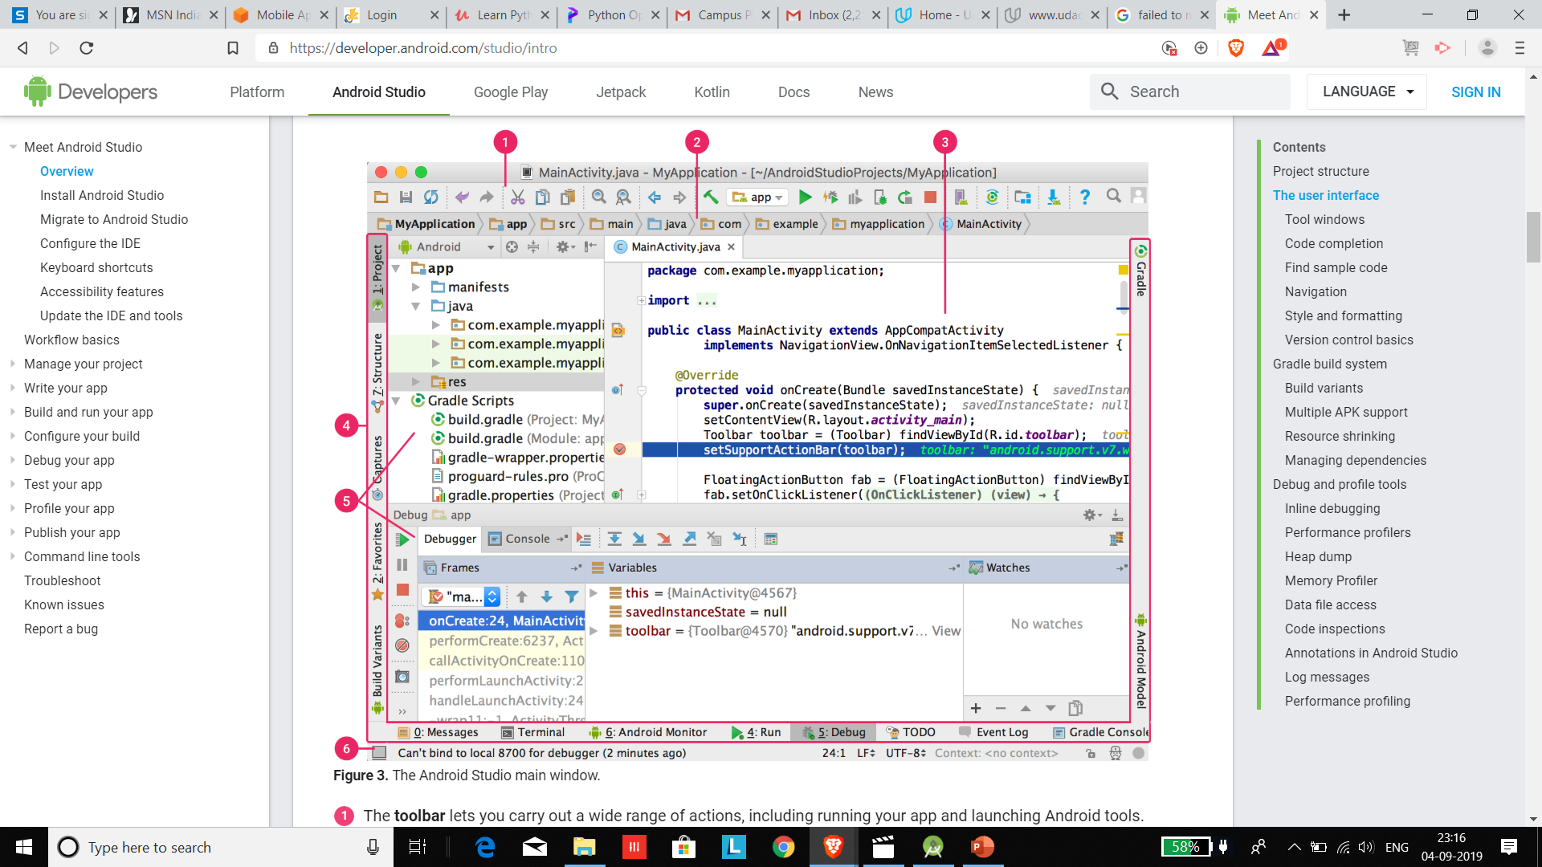
Android studio 3.5 (IDE): User interface
MR. SANTOSH S KATTI, PES UNIVERSITY, BENGALURU

Slide 14
Android studio 3.5 (IDE): User interface
The toolbar lets you carry out a wide range of actions, including running your app and launching Android tools.
The navigation bar helps you navigate through your project and open files for editing. It provides a more compact view of the structure visible in the Project window.
The editor window is where you create and modify code. Depending on the current file type, the editor can change. For example, when viewing a layout file, the editor displays the Layout Editor.
The tool window bar runs around the outside of the IDE window and contains the buttons that allow you to expand or collapse individual tool windows.
The tool windows give you access to specific tasks like project management, search, version control, and more. You can expand them and collapse them.
The status bar displays the status of your project and the IDE itself, as well as any warnings or messages
MR. SANTOSH S KATTI, PES UNIVERSITY, BENGALURU

Slide 15
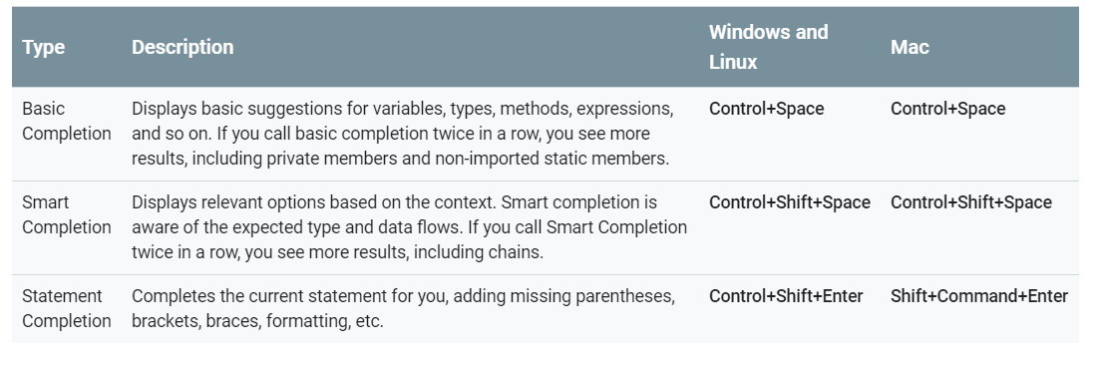
Android studio 3.5 (IDE): completion
MR. SANTOSH S KATTI, PES UNIVERSITY, BENGALURU

Slide 16
Android studio 3.5 (IDE): style & version controls
Android Studio automatically applies formatting and styles as specified in your code style settings.
To customize your code style settings, click File > Settings > Editor > Code Style (Android Studio > Preferences > Editor > Code Style on a Mac.)
Android Studio supports a variety of version control systems (VCS’s), including Git, GitHub, CVS, Mercurial, Subversion, and Google Cloud Source Repositories. (later)
MR. SANTOSH S KATTI, PES UNIVERSITY, BENGALURU

Slide 17
Features of Android studio 3.5
Gradle build system
Android Studio uses Gradle as the foundation of the build system, with more Android-specific capabilities provided by the Android plugin for Gradle. This build system runs as an integrated tool from the Android Studio menu, and independently from the command line. You can use the features of the build system to do the following:
Customize, configure, and extend the build process.
Create multiple APKs for your app, with different features using the same project and modules.
Reuse code and resources across sourcesets.
MR. SANTOSH S KATTI, PES UNIVERSITY, BENGALURU

Slide 18
Features of Android studio 3.5
Build variants
The build system can help you create different versions of the same application from a single project. This is useful when you have both a free version and a paid version of your app, or if you want to distribute multiple APKs for different device configurations on Google Play.
MR. SANTOSH S KATTI, PES UNIVERSITY, BENGALURU

Slide 19
Features of Android studio 3.5
Multiple APK support
Multiple APK support allows you to efficiently create multiple APKs based on screen density or ABI. For example, you can create separate APKs of an app for the hdpi and mdpi screen densities, while still considering them a single variant and allowing them to share test APK, javac and other settings.
MR. SANTOSH S KATTI, PES UNIVERSITY, BENGALURU

Slide 20
Features of Android studio 3.5
Resource shrinking
Resource shrinking in Android Studio automatically removes unused resources from your packaged app and library dependencies. For example, if your application is using ”Google Play Services” to access “Google Drive” functionality, and you are not currently using Google Sign-in, then resource shrinking can remove the various drawable assets for the “Signin” buttons.
MR. SANTOSH S KATTI, PES UNIVERSITY, BENGALURU

Slide 21
Features of Android studio 3.5
Managing dependencies
Dependencies for your project are specified by name in the “build.gradle” file. Gradle takes care of finding your dependencies and making them available in your build. You can declare module dependencies, remote binary dependencies, and local binary dependencies in your “build.gradle” file.
(Maven - internal)
MR. SANTOSH S KATTI, PES UNIVERSITY, BENGALURU

Slide 22
Features of Android studio 3.5
Debug and profile tools
Android Studio assists you in debugging and improving the performance of your code, including inline debugging and performance analysis tools.
MR. SANTOSH S KATTI, PES UNIVERSITY, BENGALURU

Slide 23
Android studio 3.5
Enhance Performance
Minimum of 5GB RAM should be free for smooth functioning of IDE
Increase the heap size in Memory Settings to 2048 MB (if it is less)
Real time anti-virus scan can effect the speed of Gradle build.
MR. SANTOSH S KATTI, PES UNIVERSITY, BENGALURU

Slide 24
Android studio 3.5
First App – Entry points
Activity
Main Activity (Multiple)
Broadcast services (No UI)
MR. SANTOSH S KATTI, PES UNIVERSITY, BENGALURU

Slide 25
Android studio 3.5
First App – Adapt to different devices
Different layouts for different screen sizes
Run-time query for using various device resources (camera etc)
MR. SANTOSH S KATTI, PES UNIVERSITY, BENGALURU

Slide 26
Your project
WHAT YOU LEARN?
USABILITY
MODELLING & DESIGN
UX & UI
ANDROID PROGRAMMING
APP LAUNCH

Slide 27
Lab 2 : working with emulators
Managing Android Virtual Devices
Launching Android Applications on your Device
MR. SANTOSH S KATTI, PES UNIVERSITY, BENGALURU

Slide 28
Online quiz
MR. SANTOSH S KATTI, PES UNIVERSITY, BENGALURU

Slide 29
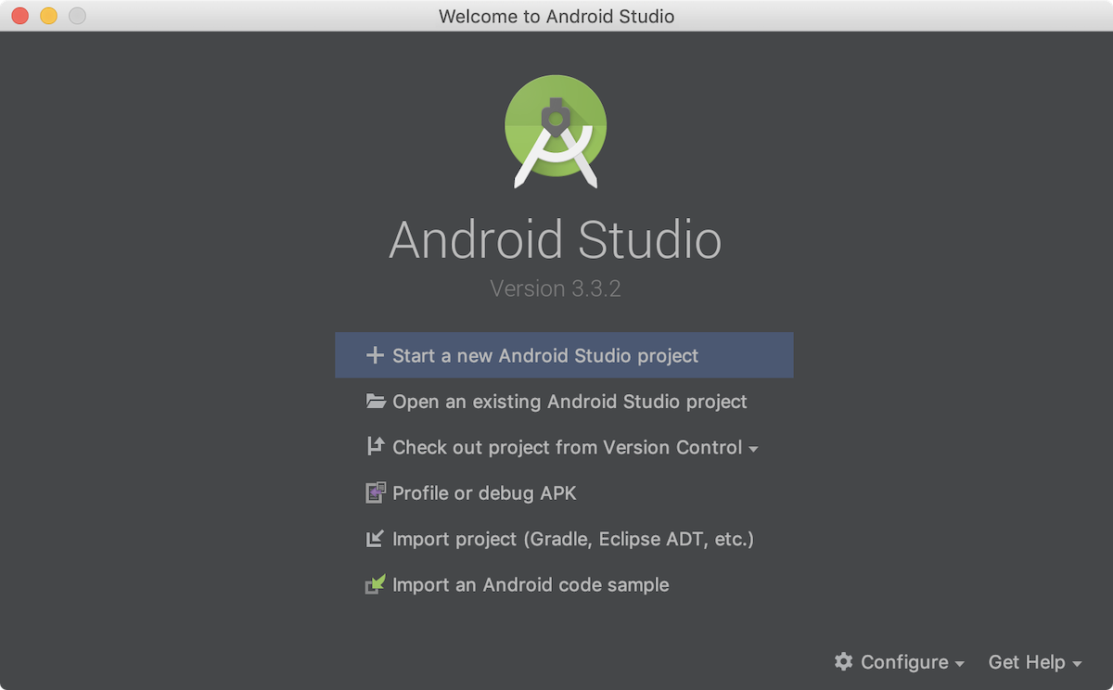
Start your first app
To create your new Android project, follow these steps:
Install the latest version of Android Studio. (https://developer.android.com/studio/)
2. In the Welcome to Android Studio window, click Start a new Android Studio project

Slide 30
Start your first app
If you have a project already opened, select File > New > New Project.
In the Choose your project window, select Empty Activity and click Next.
In the Configure your project window, complete the following:
Enter "My First App" in the Name field.
Enter "com.example.myfirstapp" in the Package name field.
If you'd like to place the project in a different folder, change its Save location.
Select either Java or Kotlin from the Language drop-down menu.
Select the checkbox next to Use androidx.* artifacts.
Leave the other options as they are.
Click Finish.

Slide 31
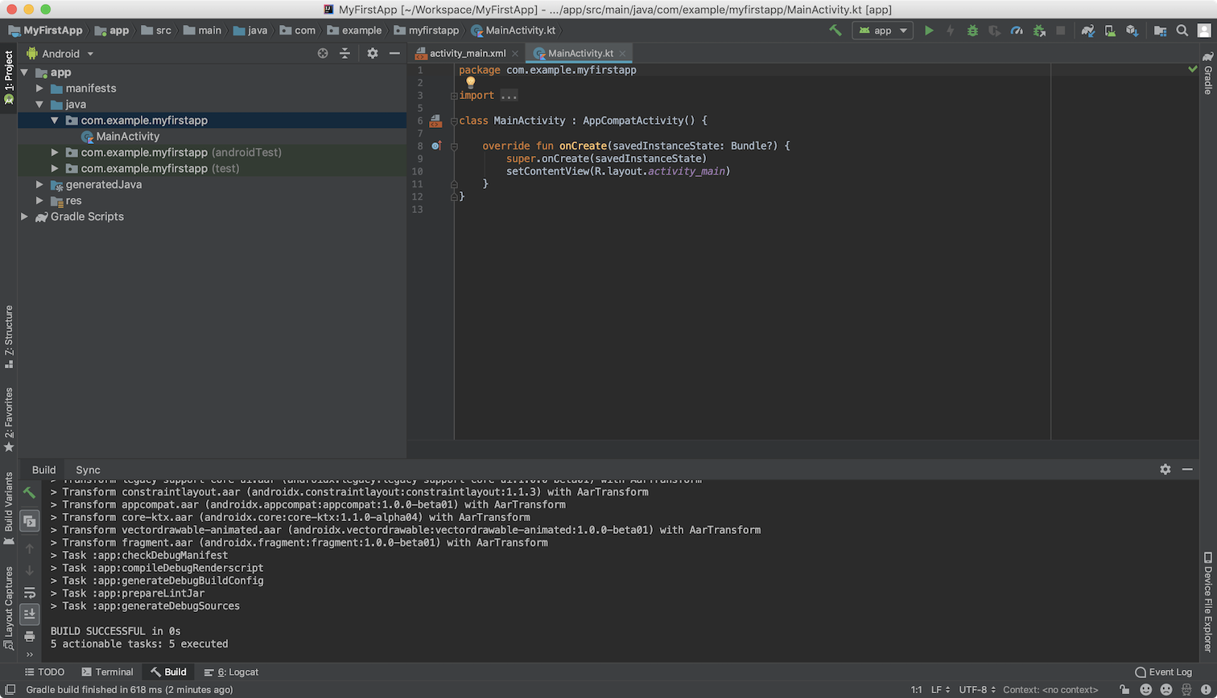
Start your first app

Slide 32
Start your first app
Run on a real device
Set up your device as follows:
Connect your device to your development machine with a USB cable. If you developed on Windows, you might need to install the appropriate USB driver for your device.
Perform the following steps to enable USB debugging in the Developer options window:
Open the Settings app.
If your device uses Android v8.0 or higher, select System. Otherwise, proceed to the next step.
Scroll to the bottom and select About phone.
Scroll to the bottom and tap Build number seven times.
Return to the previous screen, scroll to the bottom, and tap Developer options.
In the Developer options window, scroll down to find and enable USB debugging.
Run the app on your device as follows:
In Android Studio, select your app from the run/debug configurations drop-down menu in the toolbar.
In the toolbar, select the device that you want to run your app on from the target device drop-down menu.

Slide 33
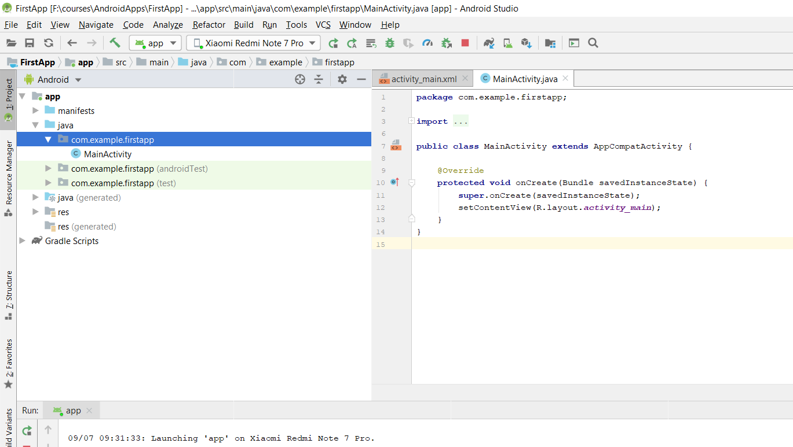
Start your first app

Slide 34
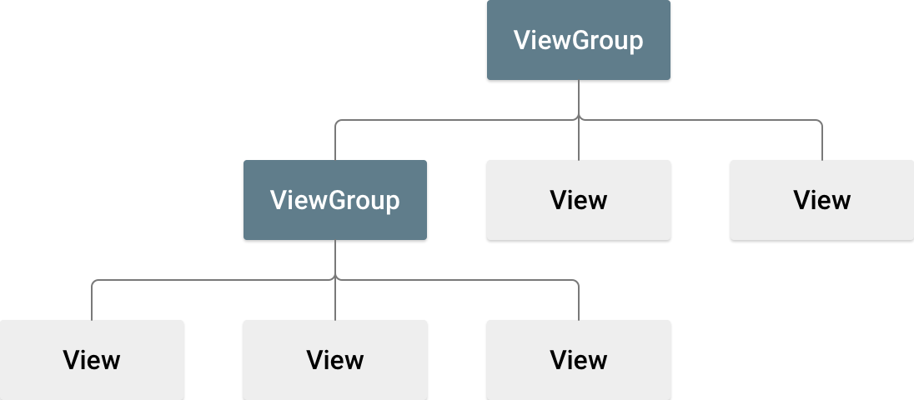
Android widgets
The user interface (UI) for an Android app is built as a hierarchy of layouts and widgets. The layouts are ViewGroup objects, containers that control how their child views are positioned on the screen. Widgets are View objects, UI components such as buttons and text boxes.

Slide 35
Android widgets
Android provides an XML vocabulary for ViewGroup and View classes, so most of your UI is defined in XML files. The Layout Editor writes the XML for you as you drag and drop views to build your layout.
BUILD A SIMPLE USER INTERFACE
Create a layout that includes a text box and a button. Learn how to make the app send the content of the text box to another activity when the button is tapped.

Slide 36



Open the Layout Editor
To get started, set up your workspace as follows:
In the Project window, open app > res > layout > activity_main.xml.
To make room for the Layout Editor, hide the Project window. To do so, select View > Tool Windows > Project, or just click Project on the left side of the Android Studio screen.
If your editor shows the XML source, click the Design tab at the bottom of the window.
Click Select Design Surface and select Blueprint.
Click Show in the Layout Editor toolbar and make sure that Show All Constraints is checked.
Make sure Autoconnect is off. A tooltip in the toolbar displays Enable Autoconnection to Parent when Autoconnect is off.
Click Default Margins in the toolbar and select 16. If needed, you can adjust the margins for each view later.
Click Device for Preview in the toolbar and select 5.5, 1440 × 2560, 560 dpi (Pixel XL)

Slide 37
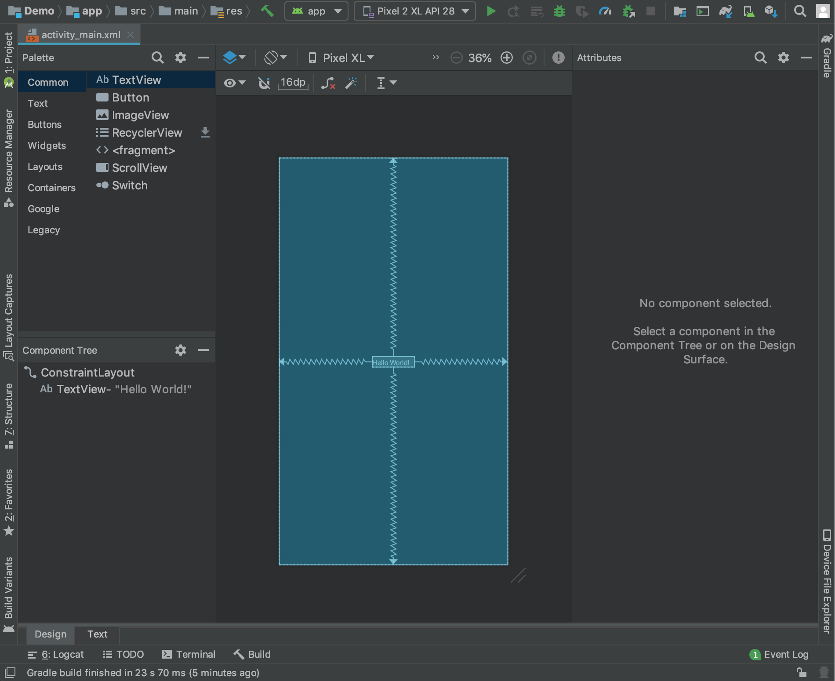


Open the Layout Editor

Slide 38
Add a text box
Follow these steps to add a text box:
First, you need to remove what's already in the layout. Click TextView in the Component Tree panel and then press the Delete key.
In the Palette panel, click Text to show the available text controls.
Drag the Plain Text into the design editor and drop it near the top of the layout. This is an EditText widget that accepts plain text input.
Click the view in the design editor. You can now see the square handles to resize the view on each corner, and the circular constraint anchors on each side. For better control, you might want to zoom in on the editor. To do so, use the Zoom buttons in the Layout Editor toolbar.
Click and hold the anchor on the top side, drag it up until it snaps to the top of the layout, and then release it. That's a contraint: it constrains the view within the default margin that was set. In this case, you set it to 16 dp from the top of the layout.
Use the same process to create a constraint from the left side of the view to the left side of the layout.

Slide 39

Add a button
In the Palette panel, click Buttons.
Drag the Button widget into the design editor and drop it near the right side.
Create a constraint from the left side of the button to the right side of the text box.
To constrain the views in a horizontal alignment, create a constraint between the text baselines. To do so, click the button and then click Edit Baseline, which appears in the design editor directly below the selected view. The baseline anchor appears inside the button. Click and hold this anchor, and then drag it to the baseline anchor that appears in the text box.

Slide 40
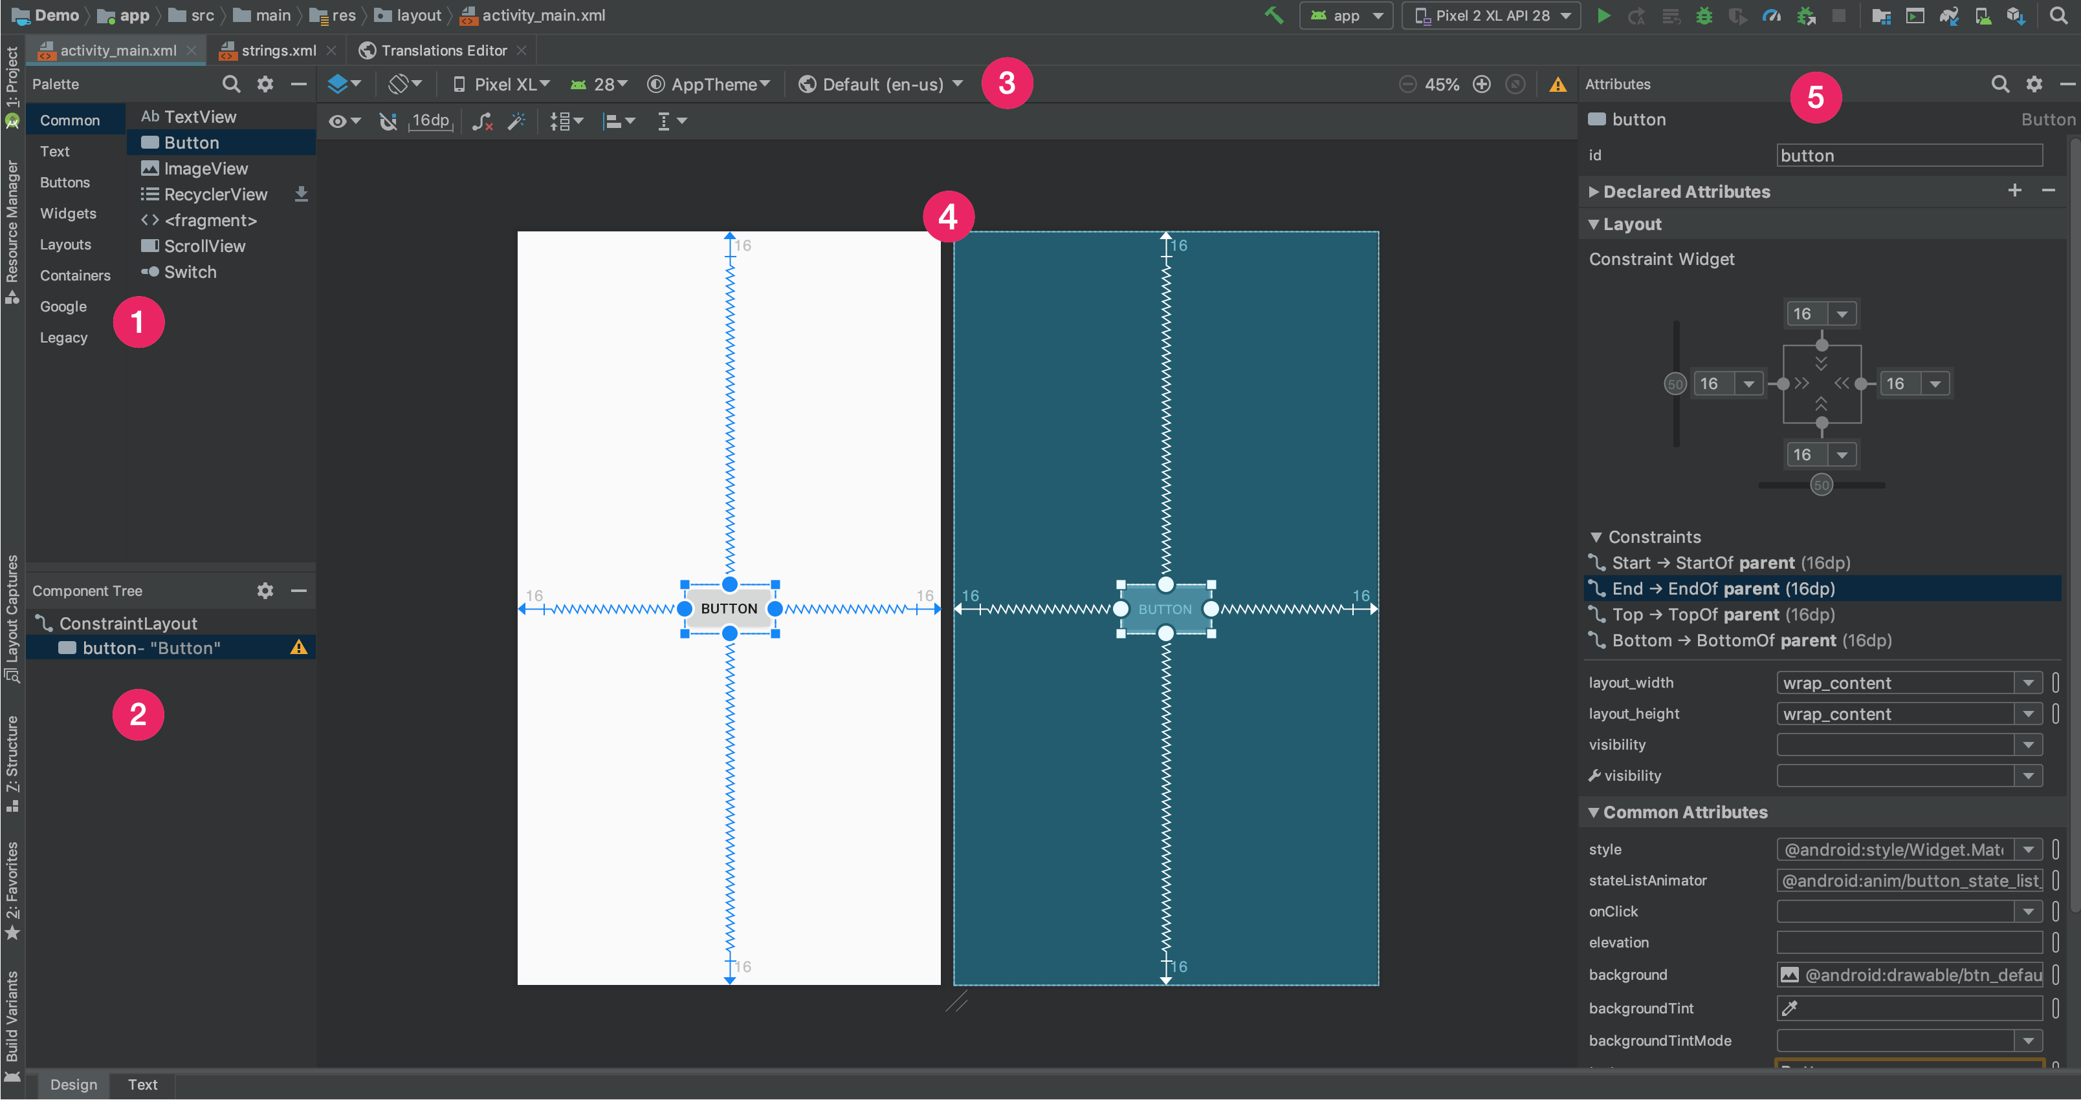
Introduction to the Layout Editor
The Layout Editor appears when you open an XML layout file.
Palette: List of views and view groups that you can drag into your layout.
Component Tree: View hierarchy for your layout.
Toolbar: Buttons to configure your layout appearance in the editor and to change some layout attributes.
Design editor: Layout in Design or Blueprint view, or both.
Attributes: Controls for the selected view's attributes.

Slide 41
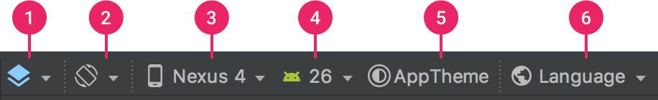
Buttons in the layout editor toolbar
1. Design and blueprint: Select how you'd like to view your layout in the editor; select either the Design view (a real-world preview of your layout), the Blueprint view (only outlines for each view), or Design + Blueprint for both side by side.Tip: Press B to cycle through these views.
2. Screen orientation and layout variants: Select between landscape and portrait screen orientation, or other screen modes for which your app provides alternative layouts, such as night mode. This menu also contains commands for creating a new layout variant.
3. Device type and size: Select the device type (phone/tablet, Android TV, or Wear OS) and screen configuration (size and density). You can select from several pre-configured device types and your own AVD definitions, or start a new AVD by selecting Add Device Definition from the list.Tip: You can resize the device size by dragging the bottom-right corner of the layout.
4. API version: Select the version of Android on which to preview your layout.
5. App theme: Select which UI theme to apply to the preview. (This works only for supported layout styles; thus many themes in this list result in an error.)
6. Language: Select the language to show for your UI strings. This list displays only the languages available in your string resources. If you'd like to edit your translations, click Edit Translations from the drop-down menu.

Slide 42
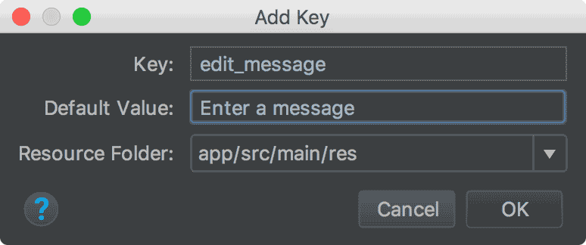

Change the UI strings
Open the Project window and then open app > res > values > strings.xml.
This is a string resources file, where you can specify all of your UI strings. It allows you to manage all of your UI strings in a single location, which makes them easier to find, update, and localize.
Click Open editor at the top of the window. This opens the Translations Editor, which provides a simple interface to add and edit your default strings. It also helps you keep all of your translated strings organized.
Click Add Key to create a new string as the "hint text" for the text box. At this point, the window shown in figure 7 opens.
Steps to change the UI strings:

Slide 43
Change the UI strings
In the Add Key dialog box, complete the following steps:
Enter "edit_message" in the Key field.
Enter "Enter a message" in the Default Value field.
Click OK.
Add another key named "button_send" with a value of "Send."
Steps to change the UI strings:

Slide 44
Change the UI strings
To preview the UI, click Select Design Surface in the toolbar and select Design
Open the Project window and then open app > res > values > strings.xml. This is a string resources file, where you can specify all of your UI strings. It allows you to manage all of your UI strings in a single location, which makes them easier to find, update, and localize.
Click Open editor at the top of the window. This opens the Translations Editor, which provides a simple interface to add and edit your default strings. It also helps you keep all of your translated strings organized.
Click Add Key to create a new string as the "hint text" for the text box. At this point.

Slide 45
Start another activity - Respond to the Send button
In the file app > java > com.example.myfirstapp > MainActivity, add the following sendMessage() method stub.
You might see an error because Android Studio cannot resolve the View class used as the method argument. To clear the error, click the View declaration, place your cursor on it, and then press Alt+Enter,to perform a Quick Fix. If a menu appears, select Import class
Return to the activity_main.xml file to call the method from the button:Select the button in the Layout Editor.
In the Attributes window, locate the onClick property and select sendMessage [MainActivity] from its drop-down list.
/** Called when the user taps the Send button */ public void sendMessage(View view) { // Do something in response to button }

Slide 46
Build an intent
An Intent is an object that provides runtime binding between separate components, such as two activities. The Intent represents an app’s intent to do something.
You can use intents for a wide variety of tasks, but here, your intent starts another activity.
In MainActivity, add the EXTRA_MESSAGE constant and the sendMessage() code, as shown:
/** Called when the user taps the Send button */ public void sendMessage(View view) { Intent intent = new Intent(this, DisplayMessageActivity.class); EditText editText = (EditText) findViewById(R.id.editText); String message = editText.getText().toString(); intent.putExtra(EXTRA_MESSAGE, message); startActivity(intent); }
Expect Android Studio to encounter Cannot resolve symbol errors again. To clear the errors, press Alt+Enter
An error still remains for DisplayMessageActivity, but that's okay. We will fix it later

Slide 47
Build an intent
Here's what's going on in sendMessage():
The Intent constructor takes two parameters, a Context and a Class.
The Context parameter is used first because the Activity class is a subclass of Context.
The Class parameter of the app component, to which the system delivers the Intent, is, in this case, the activity to start.
The putExtra() method adds the value of EditText to the intent. An Intent can carry data types as key-value pairs called extras.
Your key is a public constant EXTRA_MESSAGE because the next activity uses the key to retrieve the text value. It's a good practice to define keys for intent extras with your app's package name as a prefix. This ensures that the keys are unique, in case your app interacts with other apps.
The startActivity() method starts an instance of the DisplayMessageActivity that's specified by the Intent. Next, you need to create that class.

Slide 48
Create the second activity
To create the second activity, follow these steps:
In the Project window, right-click the app folder and select New > Activity > Empty Activity.
In the Configure Activity window, enter "DisplayMessageActivity" for Activity Name. Leave all other properties set to their defaults and click Finish.
Android Studio automatically does three things:
Creates the DisplayMessageActivity file.
Creates the layout file activity_display_message.xml, which corresponds with the DisplayMessageActivity file.
Adds the required <activity> element in AndroidManifest.xml.
If you run the app and tap the button on the first activity, the second activity starts but is empty. This is because the second activity uses the empty layout provided by the template.

Slide 49
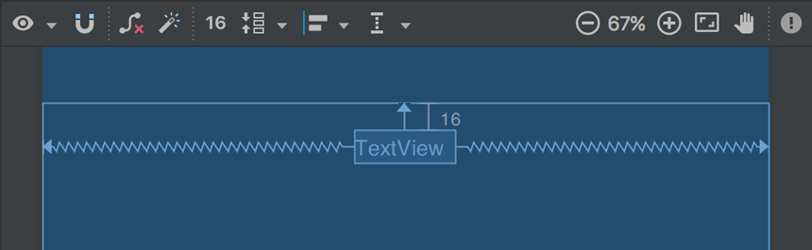
Add a text view (In new activity)
The new activity includes a blank layout file. Follow these steps to add a text view to where the message appears:
Open the file app > res > layout > activity_display_message.xml.
Click Enable Autoconnection to Parent in the toolbar. This enables Autoconnect.
In the Palette panel, click Text, drag a TextView into the layout, and drop it near the top-center of the layout so that it snaps to the vertical line that appears. Autoconnect adds left and right constraints in order to place the view in the horizontal center.
Create one more constraint from the top of the text view to the top of the layout. /?

Slide 50
Display the message In this step, you modify the second activity to display the message that was passed by the first activity.
In DisplayMessageActivity, add the following code to the onCreate() method
Press Alt+Enter to import classes
@Override protected void onCreate(Bundle savedInstanceState) { super.onCreate(savedInstanceState); setContentView(R.layout.activity_display_message); // Get the Intent that started this activity and extract the string Intent intent = getIntent(); String message = intent.getStringExtra(MainActivity.EXTRA_MESSAGE); // Capture the layout's TextView and set the string as its text TextView textView = findViewById(R.id.textView); textView.setText(message); }

Slide 51
Add upward navigation
Each screen in your app that's not the main entry point, which are all the screens that aren't the home screen, must provide navigation that directs the user to the logical parent screen in the app's hierarchy. To do this, add an Up button in the app bar.
To add an Up button, you need to declare which activity is the logical parent in the AndroidManifest.xml file. Open the file at app > manifests > AndroidManifest.xml, locate the <activity> tag for DisplayMessageActivity, and replace it with the following:
<activity android:name=".DisplayMessageActivity" android:parentActivityName=".MainActivity"> <!-- The meta-data tag is required if you support API level 15 and lower --> <meta-data android:name="android.support.PARENT_ACTIVITY" android:value=".MainActivity" /> </activity>

Slide 52
Run the app
Click Apply Changes in the toolbar to run the app. When it opens, type a message in the text field and tap Send to see the message appear in the second activity.
That's it about building your FIRST Simple App.

Slide 53
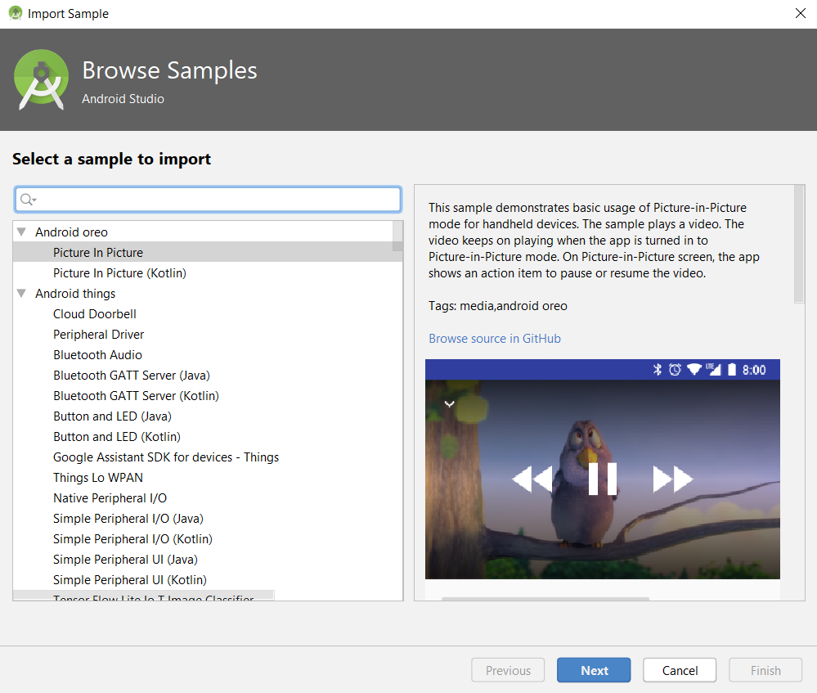
Sample Code
Select File > New > Import Sample.
Use the search box or the scroll bar to browse the samples.
When you find a sample that interests you, highlight it and take a look at the preview.
If you want to import it as a project, click Next and then Finish.

Slide 54
Connect to Firebase
Firebase is a mobile platform that helps you quickly develop high-quality apps, grow your user base (earn money?). Firebase is made up of complementary features that you can mix-and-match to fit your needs, with Google Analytics for Firebase at the core. You can explore and integrate Firebase services in your app directly from Android Studio using the Assistant window.
Google Firebase Introduction

Slide 55
Connect to Firebase
First make sure you have installed Google Repository version 26 or higher, using the following steps:
Click Tools > SDK Manager.
Click the SDK Tools tab.
Check the Google Repository checkbox, and click OK.
Click OK to install.
Click Background to complete the installation in the background, or wait for the installation to complete and click Finish.

Slide 56
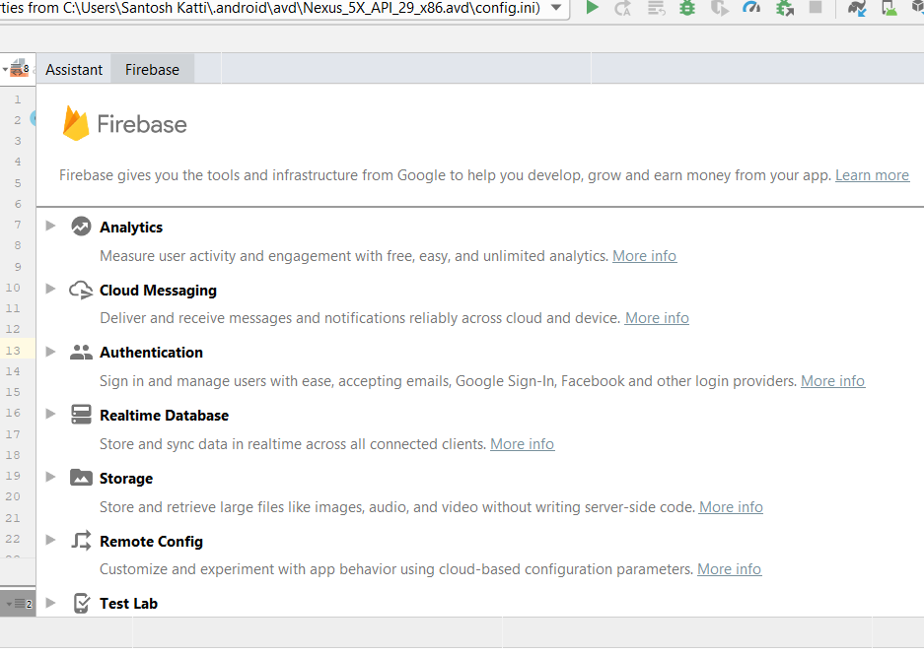
Connect to Firebase
You can now open and use the Assistant window in Android Studio by following these steps:
Click Tools > Firebase to open the Assistant window.
Click to expand one of the listed features (for example, Analytics), then click the Get Started tutorial to connect to Firebase and add the necessary code to your app.

Slide 57
Lab 3 : Building typical android applications ( 2 Labs)
Individual Project (Applications Features)
Activity / Design Requirements
Using Controls
MR. SANTOSH S KATTI, PES UNIVERSITY, BENGALURU

Slide 58
Lab 4 : Managing application resources
Managing Android Virtual Devices
Launching Android Applications on your Device
MR. SANTOSH S KATTI, PES UNIVERSITY, BENGALURU

